Slide 1

Unofficial

Slide 2
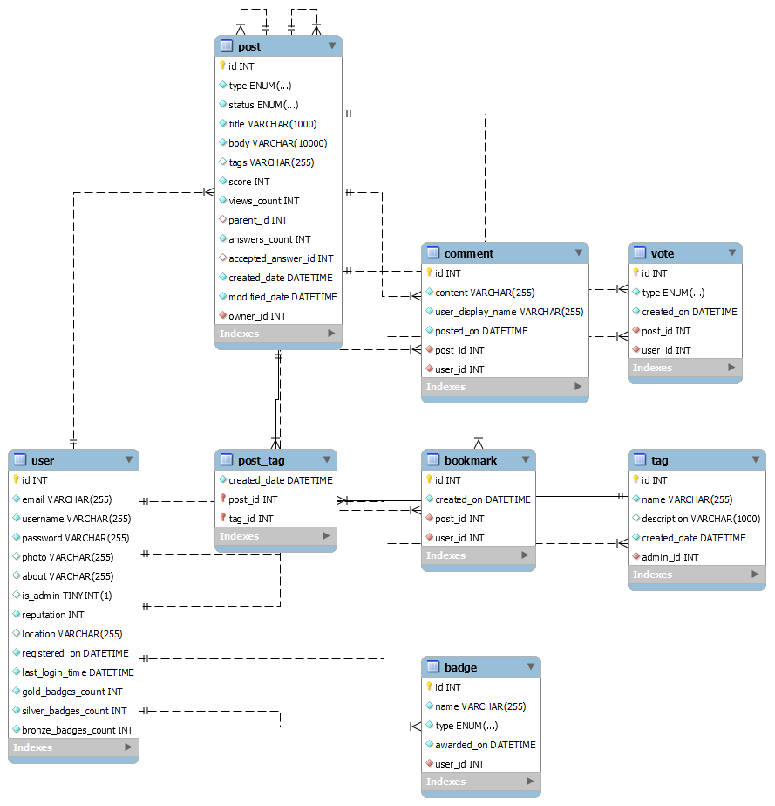
Database Schema for MySQL Tables

Slide 3
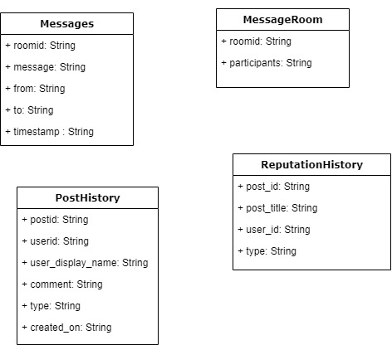
Database Schema for MongoDB Tables (Cont)

Slide 4
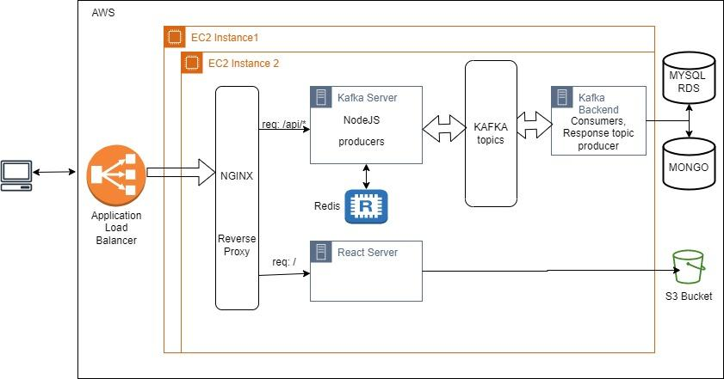
System Architecture Design

Slide 5
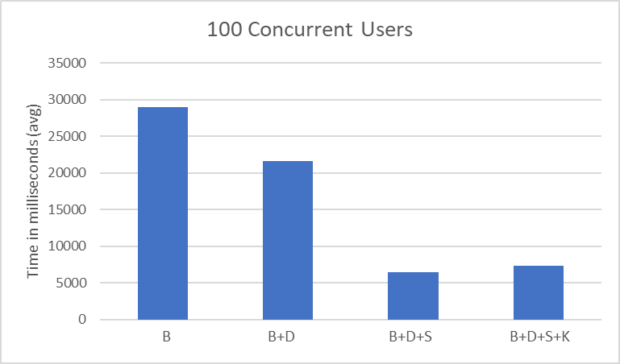
Performance Analysis for 100 concurrent users

Slide 6
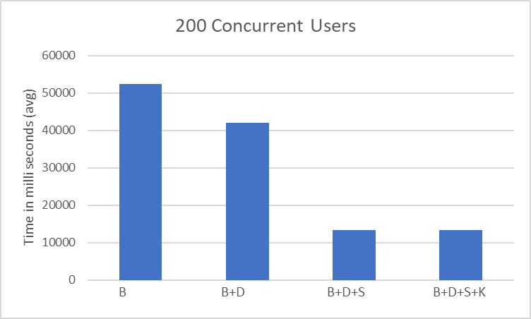
Performance Analysis for 200 concurrent users

Slide 7
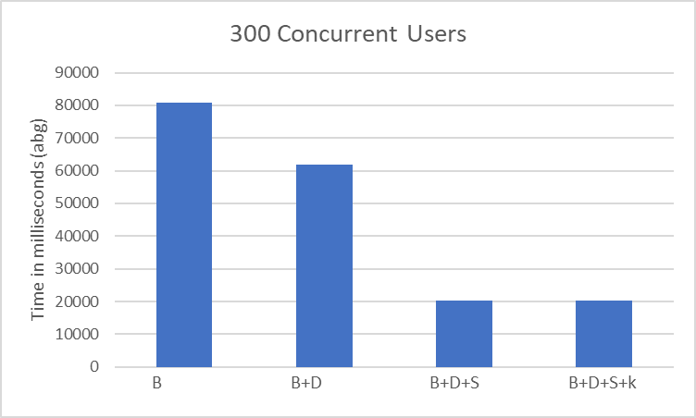
Performance Analysis for 300 concurrent users

Slide 8
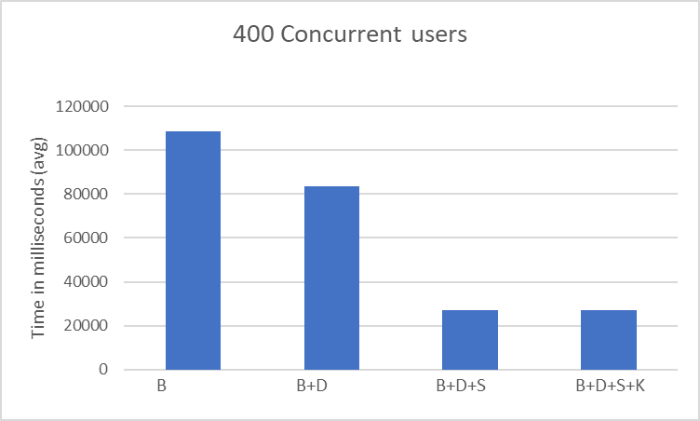
Performance Analysis for 400 concurrent users

Slide 9
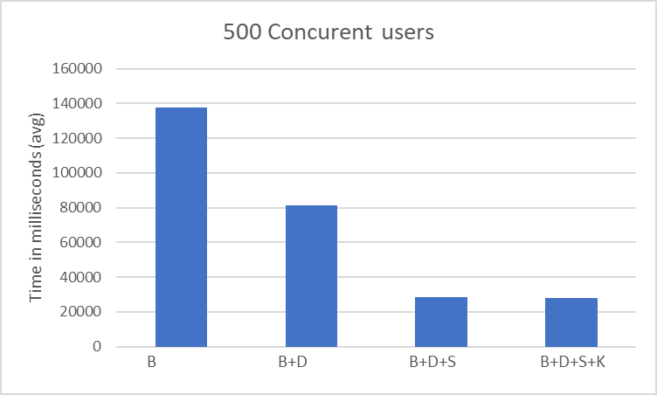
Performance Analysis for 500 concurrent users

Slide 10
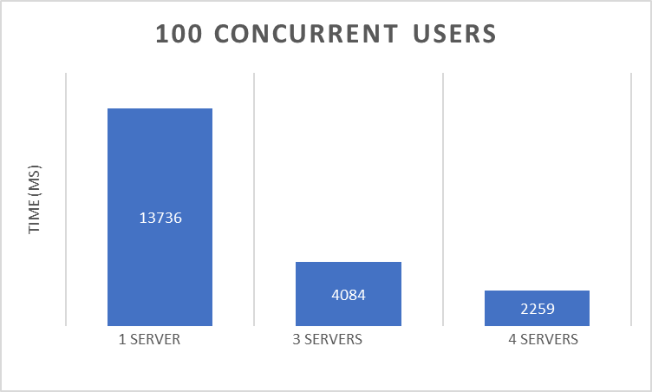
Performance comparison of services with different deployment configurations with Load Balancers

Slide 11
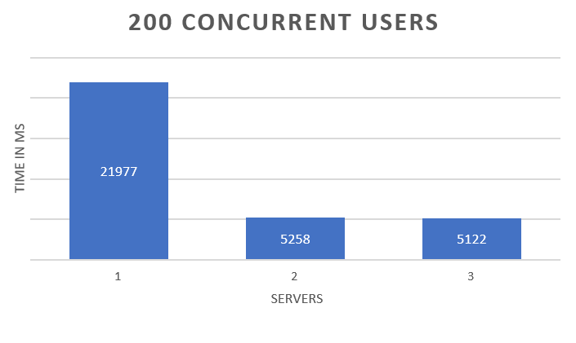
Performance comparison of services with different deployment configurations with Load Balancers

Slide 12
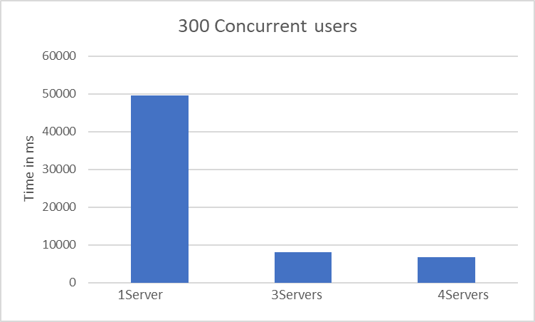
Performance comparison of services with different deployment configurations with Load Balancers

Slide 13
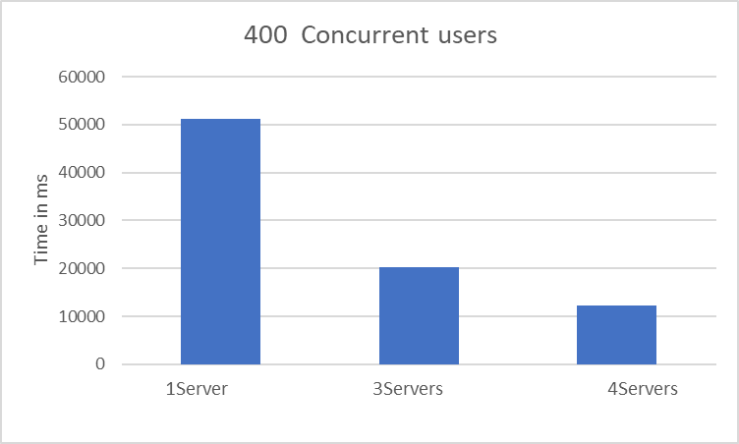
Performance comparison of services with different deployment configurations with Load Balancers

Slide 14
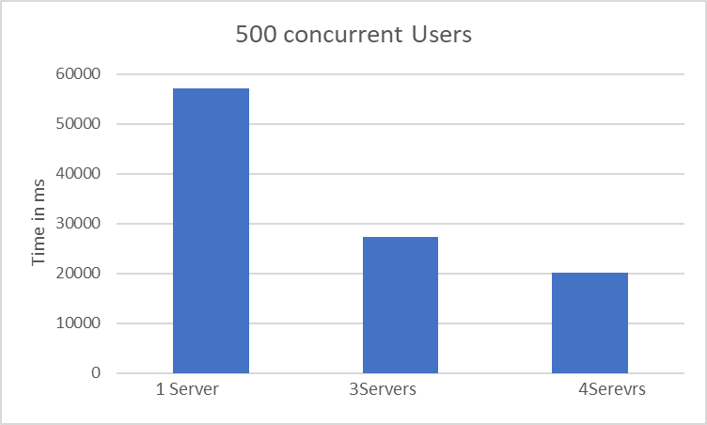
Performance comparison of services with different deployment configurations with Load Balancers

Slide 15
THANK YOU!

